Slide 1
Functional and asynchronous programming and aspects in JavaScript
Part 1

Slide 2
Agenda
Elements of functional programming.
Function prototypes.
Object oriented approach in ES6.
Callbacks and operations like call, apply, bind and scope management.
Event loop.
Async script loading.
Introduction to concept of deferred and promises.

Slide 3
Elements of functional programming
The key difference starts with how a program handles data in parallel OR asynchronous programming ways?
Immutability is the key of functional programming.
f(a) == f(b) when a == b.
How safe is the state of data or object.
No assignment operators.
Iteration by forEach not usual for-loop.
Use arrow functions. Then enforce atomicity, transparency, reproducibility and immutability.
Very nice talk about values, references and passing them: https://youtu.be/-6BsiVyC1kM

Slide 4
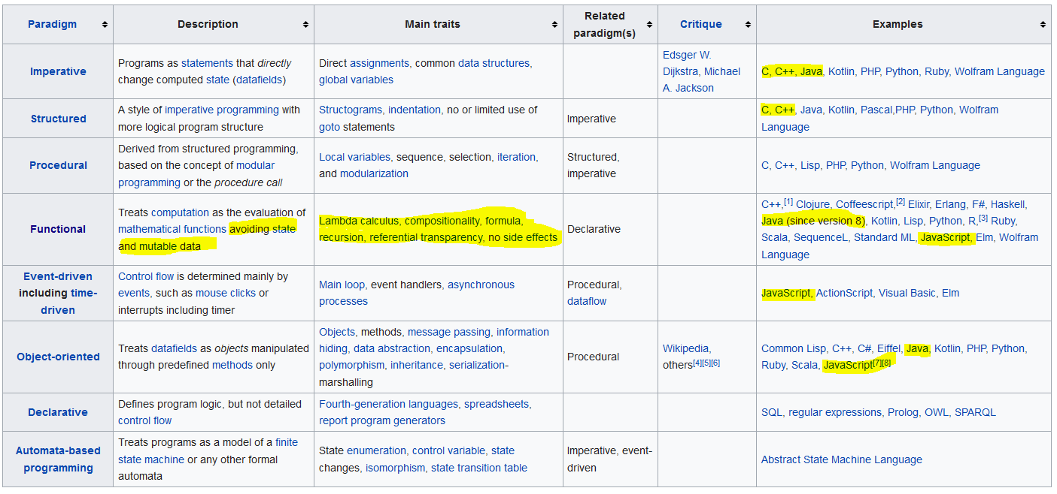
Elements of functional programming

Slide 5
Elements of functional programming
So the elements:
Immutability, pure functions, flow is around data, pass functions as parameters or return types, dynamic typing.
Recursion Or functions calling functions.
Handling of scopes when functions call functions.
Blog about functional programming in java

Slide 6
Function prototypes.
Why do we need objects in JavaScript?
Advantages of OO, reusability.
Object creation.
Why not creator functions? createEmpoyee instead of Employee Class?
Why do we need new operator for object creation?
Advantages and hacks of prototype object.
New elements in ES6:
class keyword, single constructor functions, static blocks, extends and super.
Can extend in-built classes like HTMLElement, Date, Array etc.
Nice reference: https://googlechrome.github.io/samples/classes-es6/
Web components: https://www.polymer-project.org/blog/es6
Arrow functions. No this reference, cant be used as constructor
Whats the mid-way between Pure object oriented and functional?

Slide 7

Function prototypes.
Objects are needed and atomic functions too.
Common elements which don’t have any direct association to any specific object, should not put as a part of any Class.

Slide 8
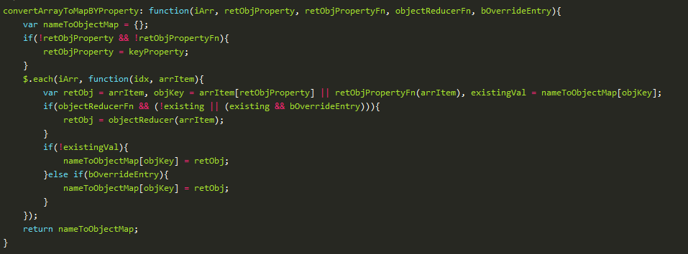
Callbacks apply, bind and scope management.
Samples
Sample util function to do array conversions:

Slide 9
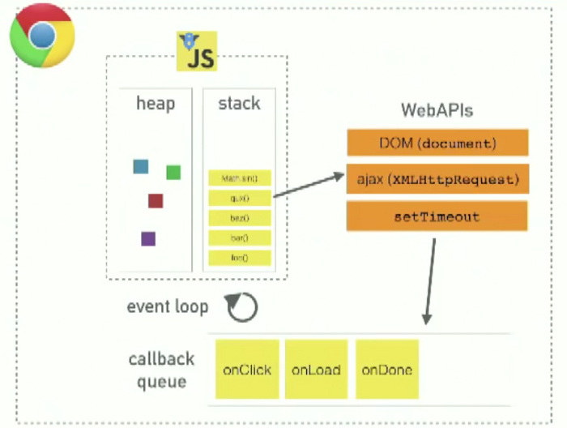
Event loop
JavaScript is single threaded and has single call-stack
How do ajax call, setTimeout and setInterval work then?
Queue: Browser events, timeouts, DOM lifecycle events, callbacks, promises, fetch requests, I/O requests if node api’s. Non-blocking, works with callbacks.
Stack: Data structure used to maintain call stack.
Event loop: Supported by most browser, runs every browser tab, to make every process isolated.
Event loop has preference to promises than timeouts.
There can be multiple event loops with web-workers and iFrames.

Slide 10
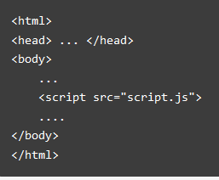
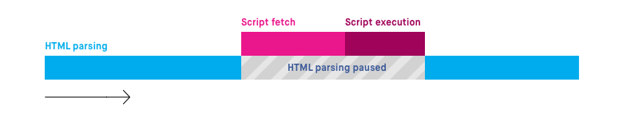
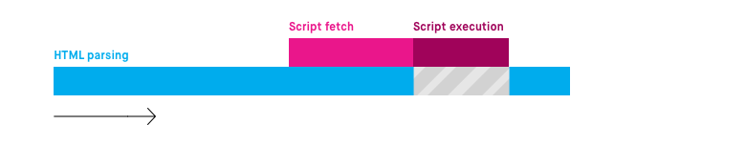

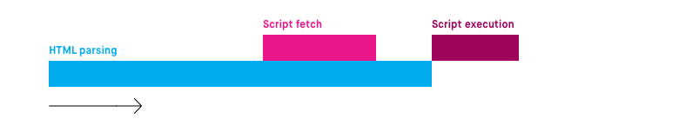

Async script loading.

Slide 11
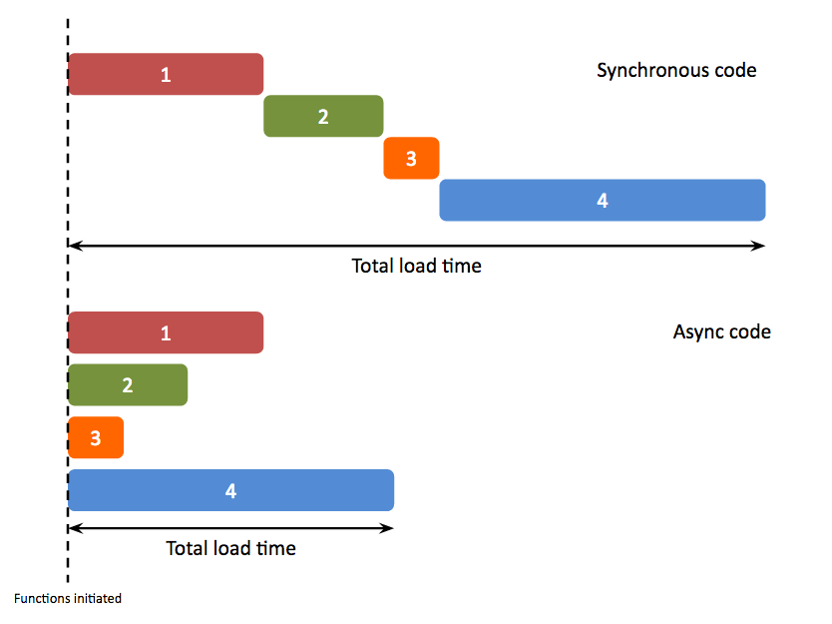
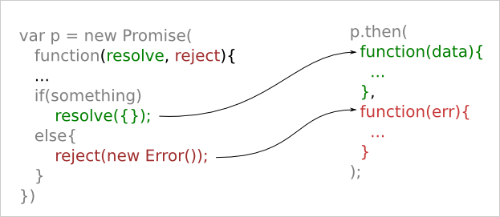
Introduction to concept of deferred and promises
Interrupted iterator:

